Slide 1
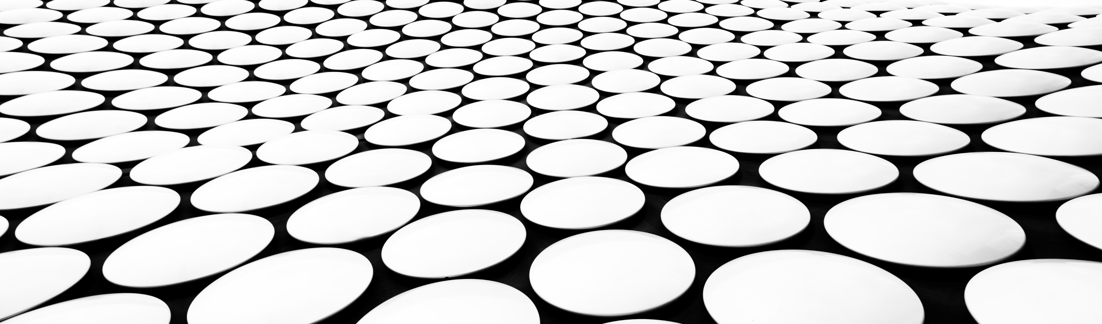
BT2123 : BIOMOLECULAR SIMULATIONS Interaction of graphene with lipid bilayer membrane
Aryan sharan reddy | bt21btech11002

Slide 2
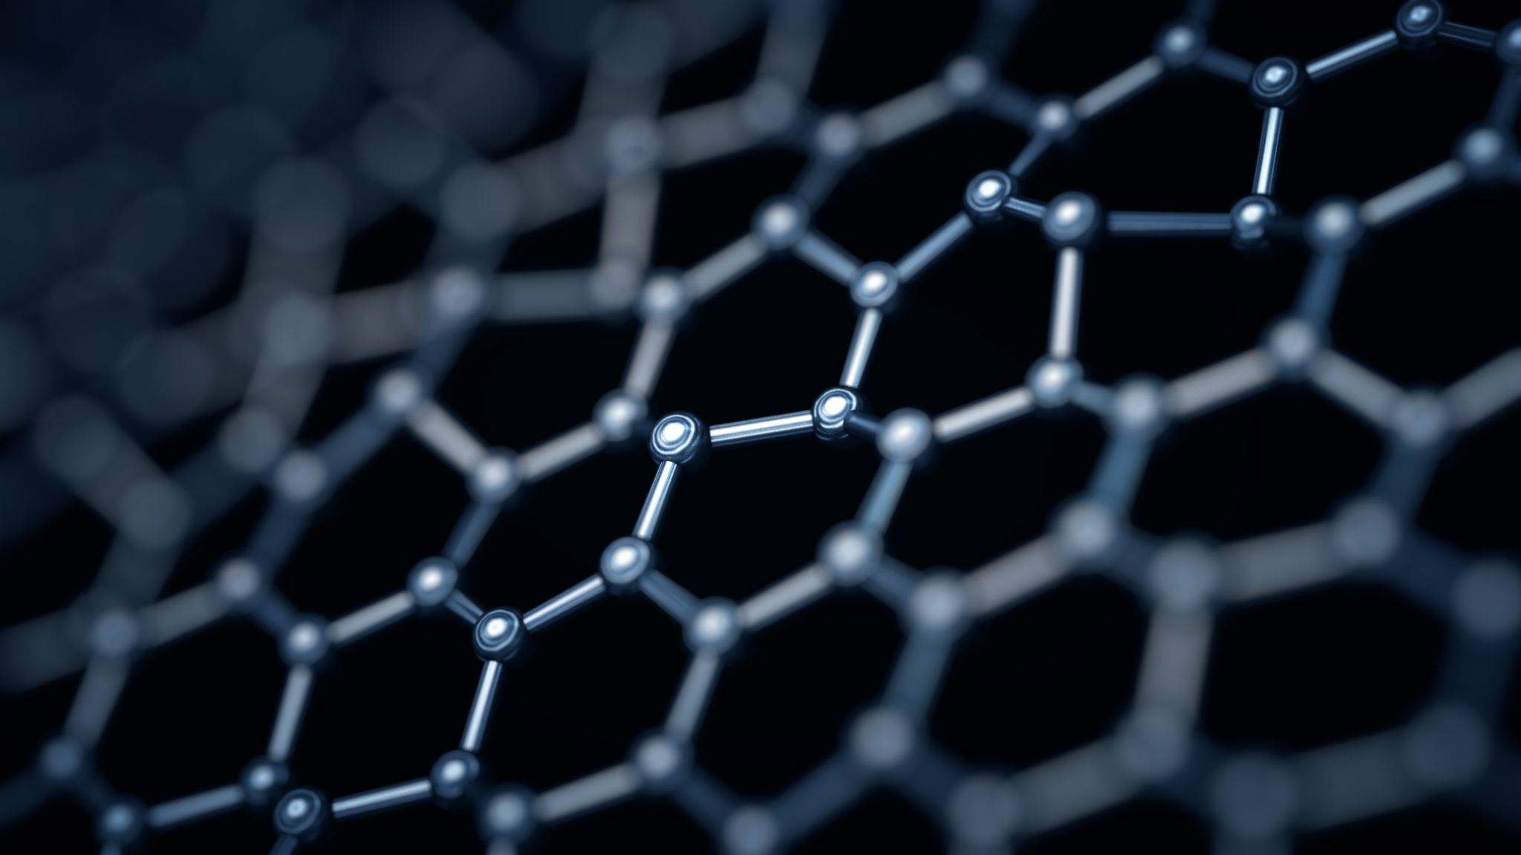
introduction
DOPC (1,2-dioleoyl-sn-glycero-3-phosphocholine) is a type of phospholipid commonly used in the study of lipid bilayers.
Graphene is a single layer of carbon atoms arranged in a two-dimensional honeycomb lattice. It is the basic building block of other carbon-based materials like graphite, carbon nanotubes, and fullerenes.
Graphene is a highly conductive material, both thermally and electrically (due to large delocalized electron system and high surface area), and is also incredibly strong and lightweight. It has a wide range of potential applications, including in electronics, energy storage, and biomedicine.
The interaction between graphene and lipid bilayers is complex and depends on various factors such as the size and shape of graphene, the type of lipid, and the presence of other molecules.
These interactions have been a subject of study and research in recent years due to their potential applications of graphene in drug delivery, bio-sensing, and nanoelectronics.

Slide 3
Motivation
The interaction of lipid bilayer membrane with graphene sheets on both sides has potential applications in various fields. Some of the applications are:
Drug delivery: The graphene sheets can be functionalized with specific drugs or genes and then used to interact with lipid bilayer membranes. This can facilitate the targeted delivery of drugs to specific cells or tissues.
Biosensors: The interaction between graphene and DOPC lipid bilayer membrane can be used to develop highly sensitive biosensors. The graphene sheets can be functionalized with receptors or enzymes that bind to specific analytes, such as proteins or DNA. When the analyte binds to the receptor or enzyme, it causes a change in the graphene's electrical conductivity, which can be measured and used to detect the presence of the
Biomedical implants: Graphene-DOPC lipid bilayer membranes have potential applications as coatings for biomedical implants, such as pacemakers and prosthetic devices. The graphene sheets can help prevent bacterial growth on the surface of the implant, reducing the risk of infection. They can also improve the biocompatibility of the implant and reduce the body's immune response to the foreign material.

Slide 4
Problem statement
Why do we have to study the interaction of carbon nanomaterials (like graphene) with the lipid bilayer membrane?
Understanding the interaction between carbon nanomaterials and cell membranes is vital for learning how to avoid adverse effects and nanomedical applications. To better understand the nature of such perturbations, we performed molecular dynamics simulations to provide molecular details about the molecular mechanism.

Slide 5
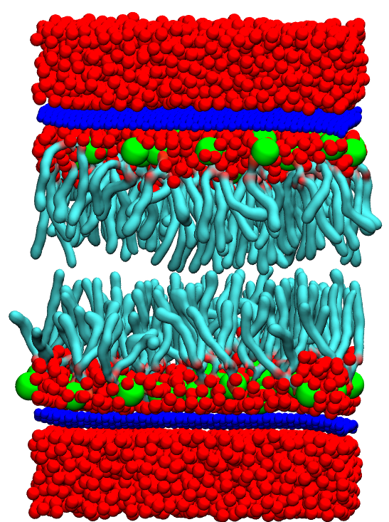
PARAMETERS FOR MY SIMULATION
MD Software Package: NAMD
Visualization of Simulation: Visual Molecular Dynamics(VMD)
Type of Lipid Chosen: DOPC(1,2-Dioleoyl-sn-glycero-3-phosphocholine)
Lipid Membrane Builder: CHARMM-GUI
Number of Lipids on Each Leaf: 52
Graphene (resname GRA) Sheet Builder: VMD
Number of Graphene Sheets Used: 2(on either side of the bilayer)
Dimensions of Graphene sheet: 6 nm x 6 nm
Total number of atoms: 34371
Force Field: CHARMM36
Model Used: All atom model
Red: Water
Dark Blue: Graphene
Green: Polar Head Group
Cyan: Hydrophobic Tail group

Slide 6
Simulation model and method
Goal: To be able to simulate the “Interaction of DOPC lipid bilayer membrane with graphene sheet” using NAMD and visualize in VMD.
First, we have created a system file (.pdb) for the DOPC lipid bilayer and graphene sheets. From there we generated the (.psf) file for the same system.
Then we created the configuration file (npt.namd) for NAMD, specifying the simulation parameters such as time step ( 2fs for bonded and 1fs for non-bonded ), pressure ( 1 atm), temperature (300 K in our case) etc.
Then we ran NAMD with the configuration files and the input files as input
Then from the output files generated, load the trajectory file (.dcd) and (.psf) file using VMD.
Apply appropriate representations to visualize the system, such as surface representation for graphene sheets and membrane representation for DOPC lipids.

Slide 7
Observations and inference
As time passes, it can clearly be observed that the bilayer membrane slowly changes its orientation, transitions through a micelle like phase and finally become vertical
This is because the hydrophobic graphene sheet will be repulsive towards the hydrophilic head groups of the lipids. And the hydrophobic tail groups of the lipid will try to move towards graphene sheet and will try to get the maximum surface area in contact with the graphene sheet.

Slide 8
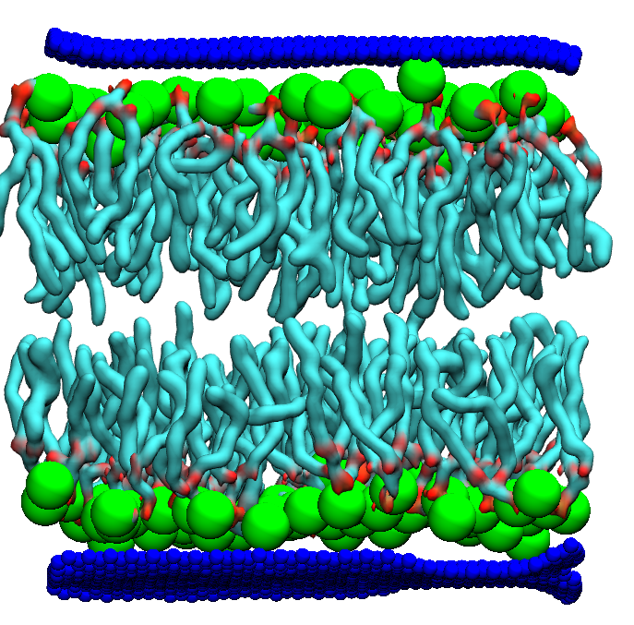
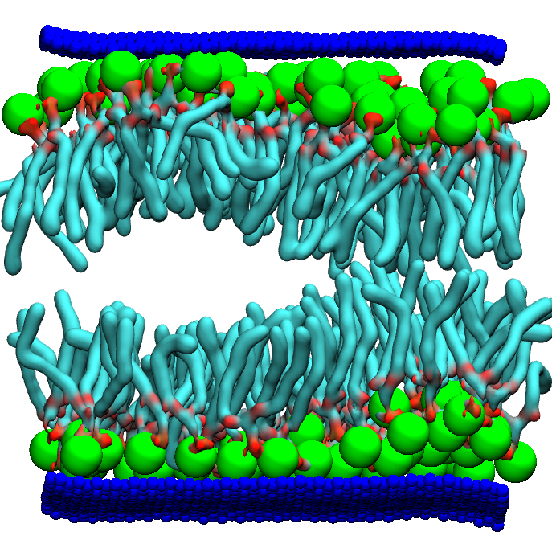
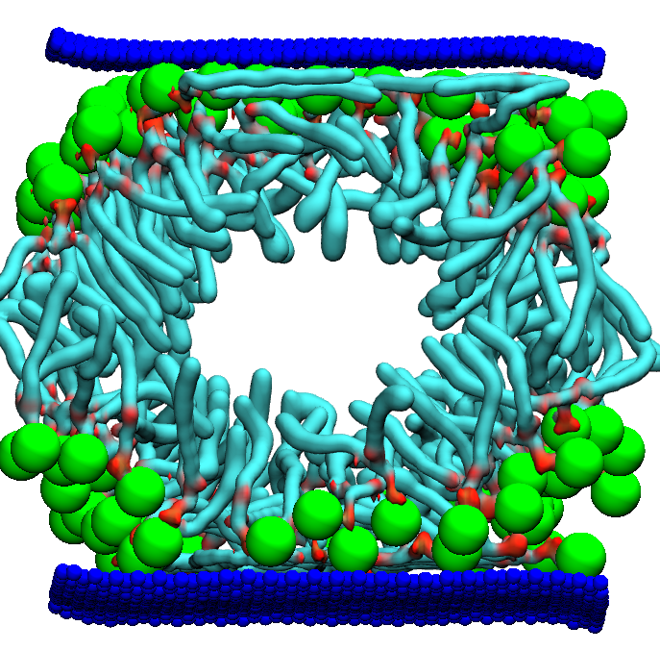
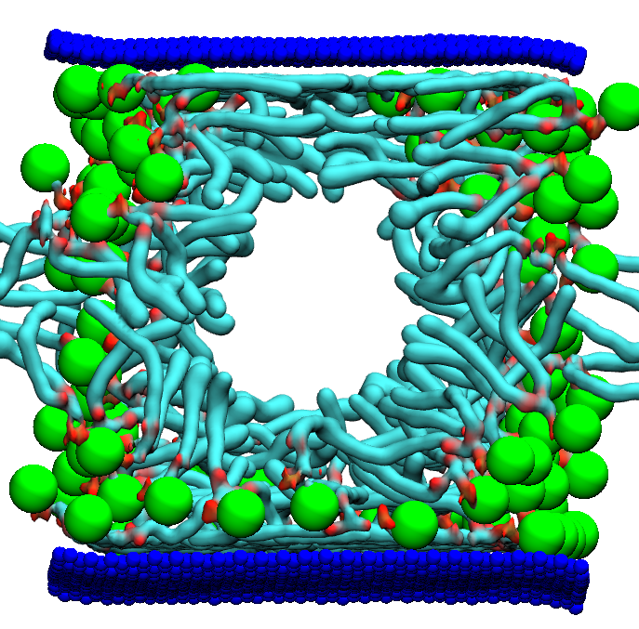
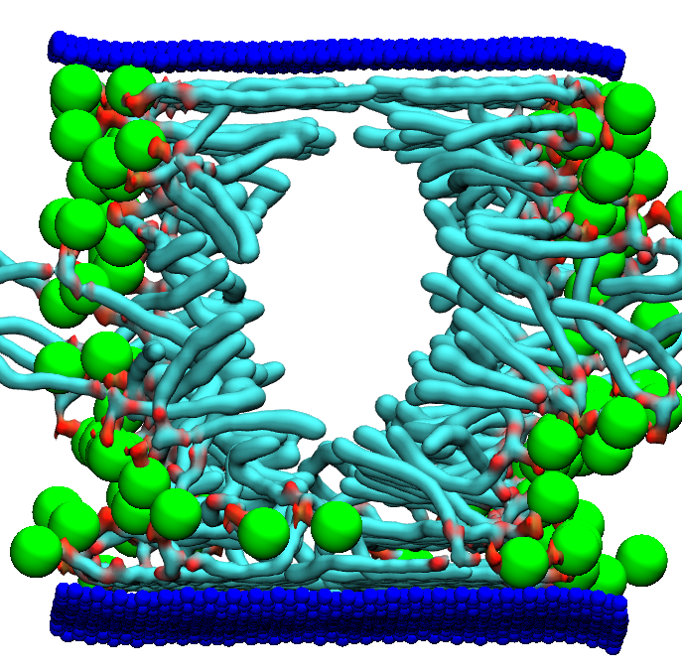
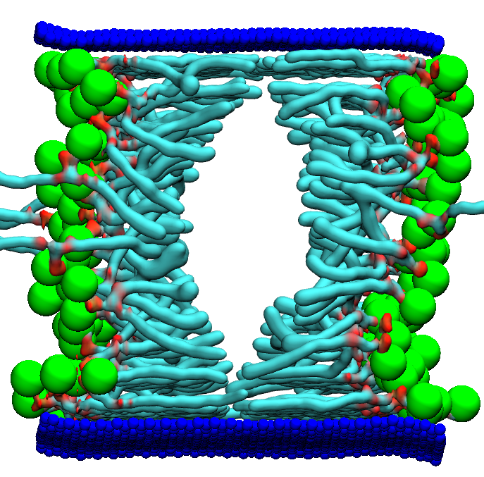

Slide 9
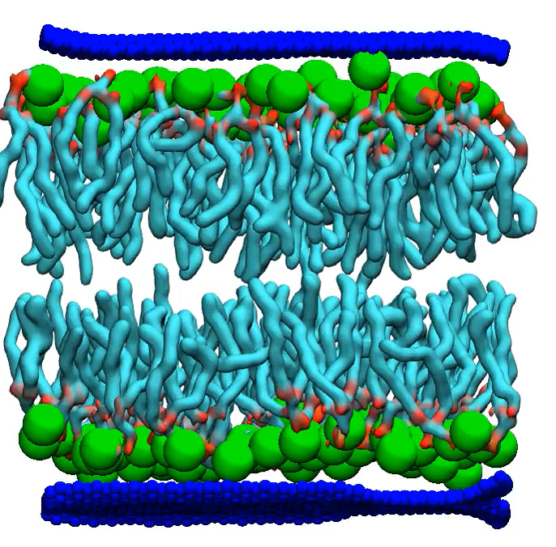
Simulation movie 1
Notice how the lipid bilayer membrane gradually becomes inverted. This is a 17 seconds video consisting of around 6656 frames with a step of 10 frames. But the simulation time is around 125ns (i.e. the changes that you can see tend to happen within that particular time frame).

Slide 10
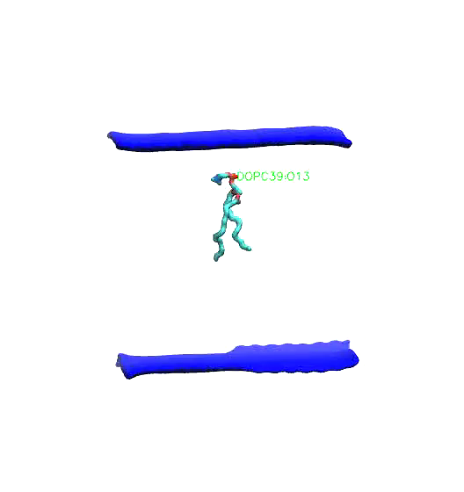
Simulation movie 2 (Single lipid)
This is a single lipid simulation movie. Notice how the lipid gradually moves from the center towards the extreme left of the membrane space.

Slide 11
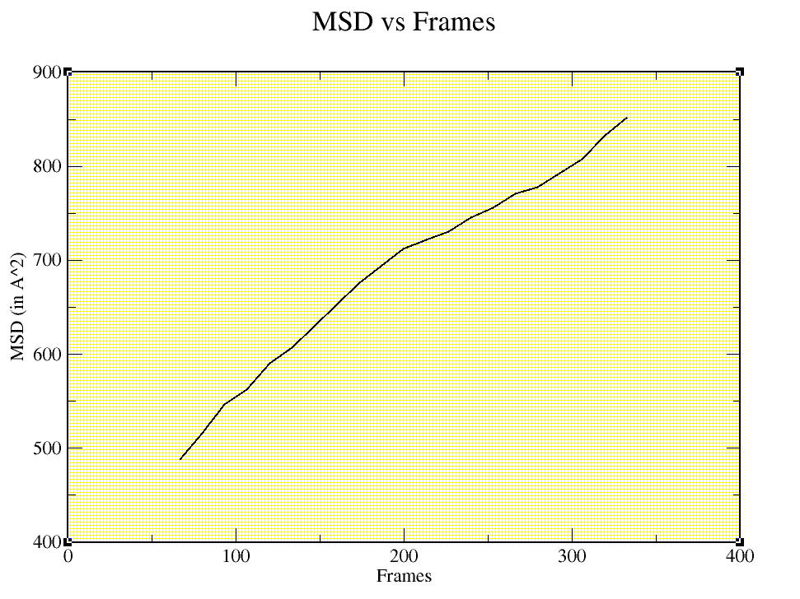
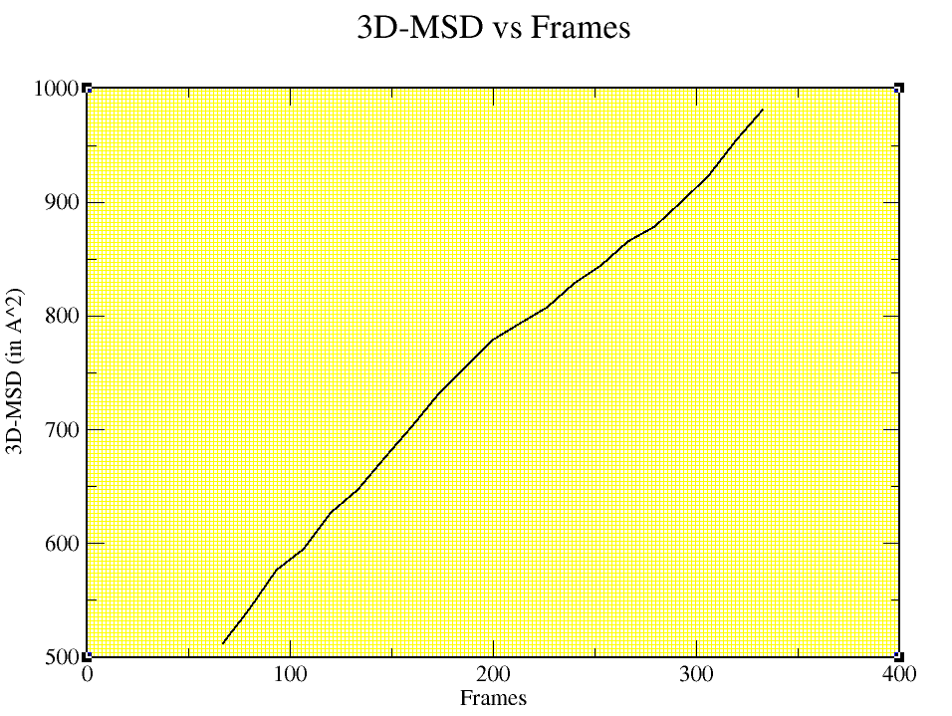
MEAN SQUARE DISPLACEMENT VS NUMBER OF FRAMES
The MSD vs. number of frames plot shows how much the lipid molecule moves or fluctuates over time. A lipid with a small MSD value indicates that it is relatively stable and does not undergo much motion or deformation, while a lipid with a large MSD value indicates that it is more flexible and undergoes more movement and deformation.
A linear increase in the MSD over time indicates that the lipid molecule undergoes diffusive motion,

Slide 12
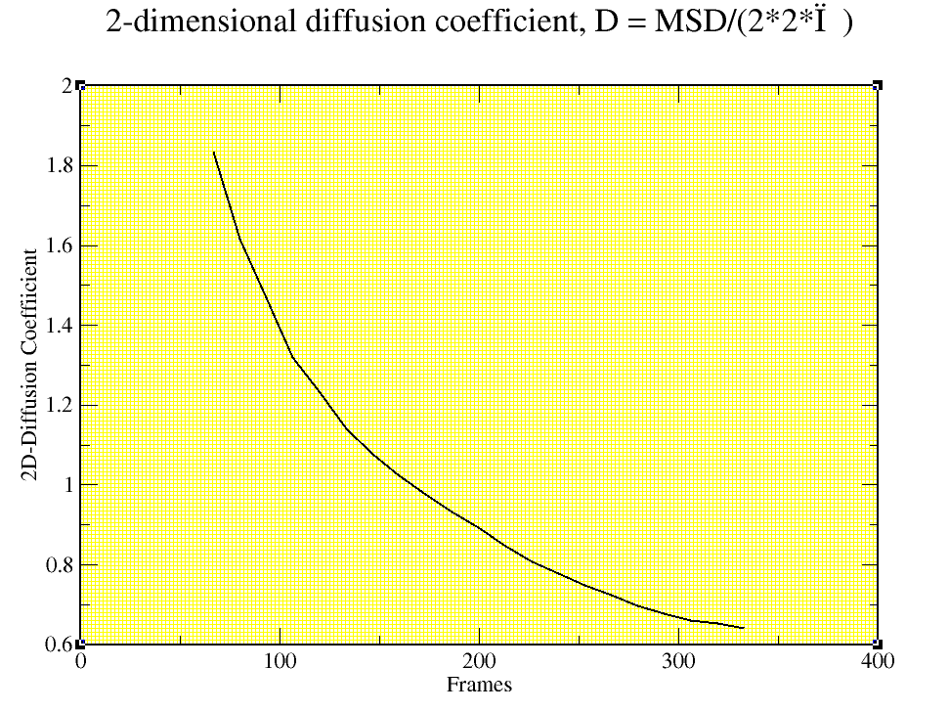
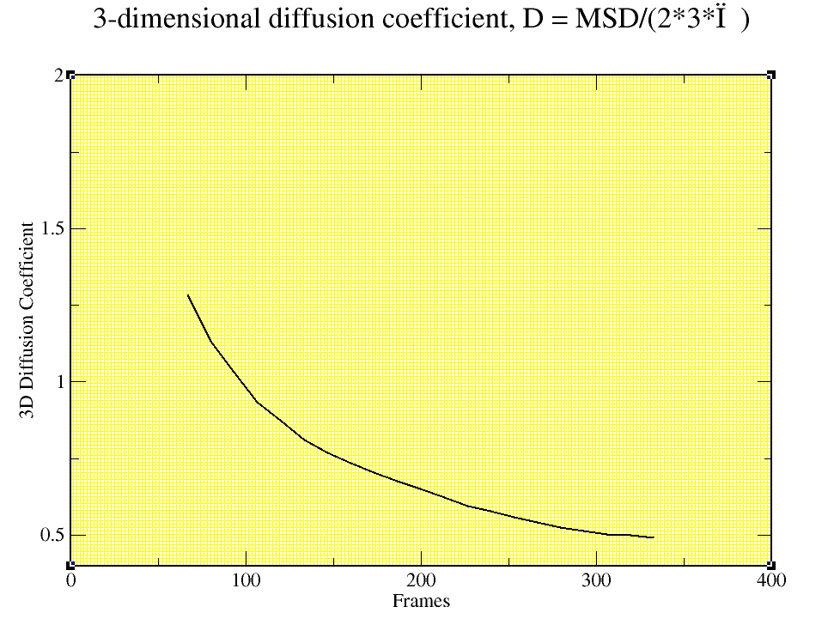
DIFFUSION COEFFICIENT VS NUMBER OF FRAMES GRAPH
The diffusion coefficient vs number of frames in molecular dynamics (MD) simulation indicates how the position of a lipid molecule changes over time. The diffusion coefficient is a measure of the mobility of a molecule in a solution. The slope of the MSD vs time gives the diffusion coefficient of the lipid. A higher diffusion coefficient indicates that the lipid molecule is more mobile and can move around more freely in the simulated system. This can be indicative of a more fluid or disordered lipid bilayer, while a lower diffusion coefficient can suggest a more ordered or structured lipid bilayer.

Slide 13
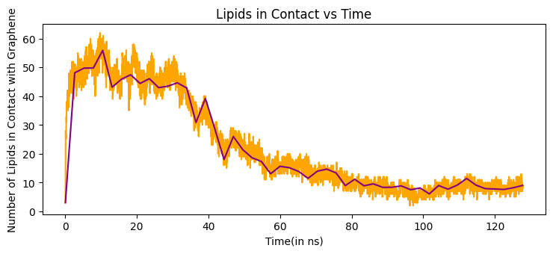
NUMBER OF LIPIDS IN CONTACT WITH THE GRAPHENE SHEET VS SIMULATION TIME
This is an analytical graph which shows us the number of lipid molecules in contact with the graphene sheet. We can observe that the number of lipids in contact at 0ns is around 3 and till around 15ns the number increases. After 15ns the number of lipids in contact falls drastically.

Slide 14
References
https://www.bing.com/new
https://pubs.acs.org/doi/pdf/10.1021/acsnano.6b07352
https://pubs.acs.org/doi/pdf/10.1021/acsnano.7b01071
https://chat.openai.com/
THANK YOU!!

